Slide 1
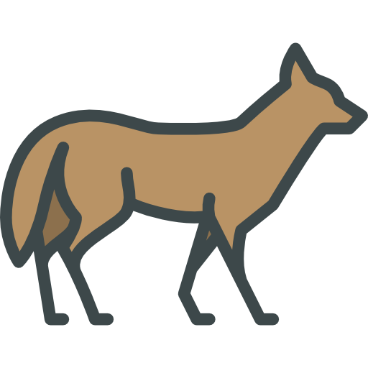
LoRaWAN implementation for acoustic localization of coyotes
Team Coyote1
2022 KSW Fall Program - Final Presentation
Notes:
Hello, this is the final presentation of team coyote 1.

Slide 2
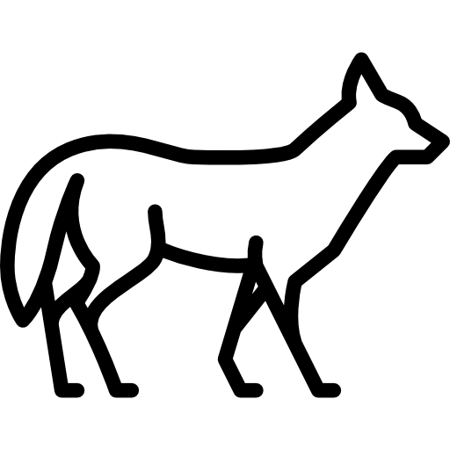
01. Introduction
02. Implementation
CONTENTS
03. Experiment
04. Future works
2022 KSW Fall Program - Final Presentation
Notes:
We split our progress into four sections.

Slide 3
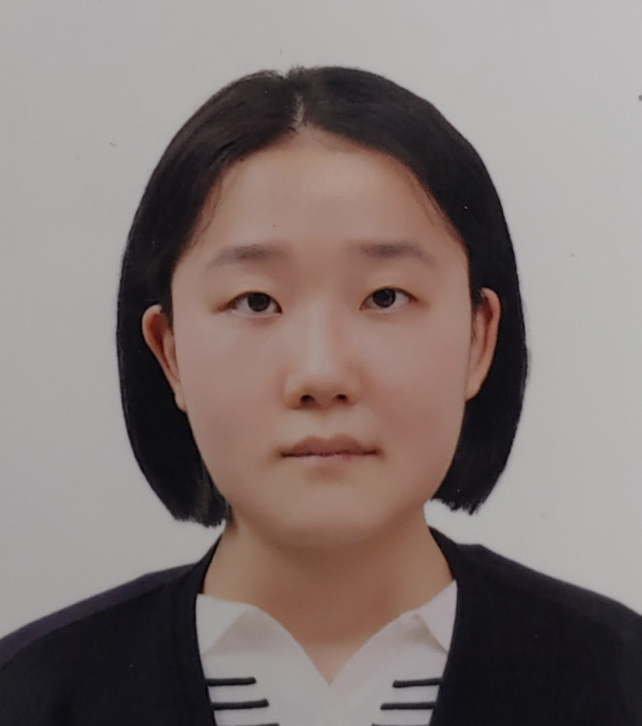
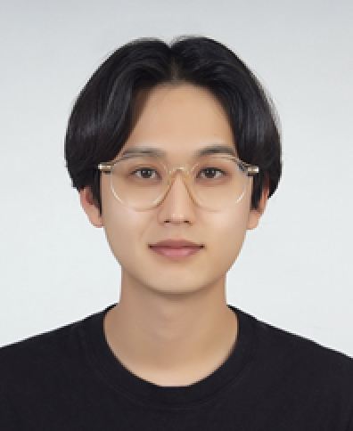
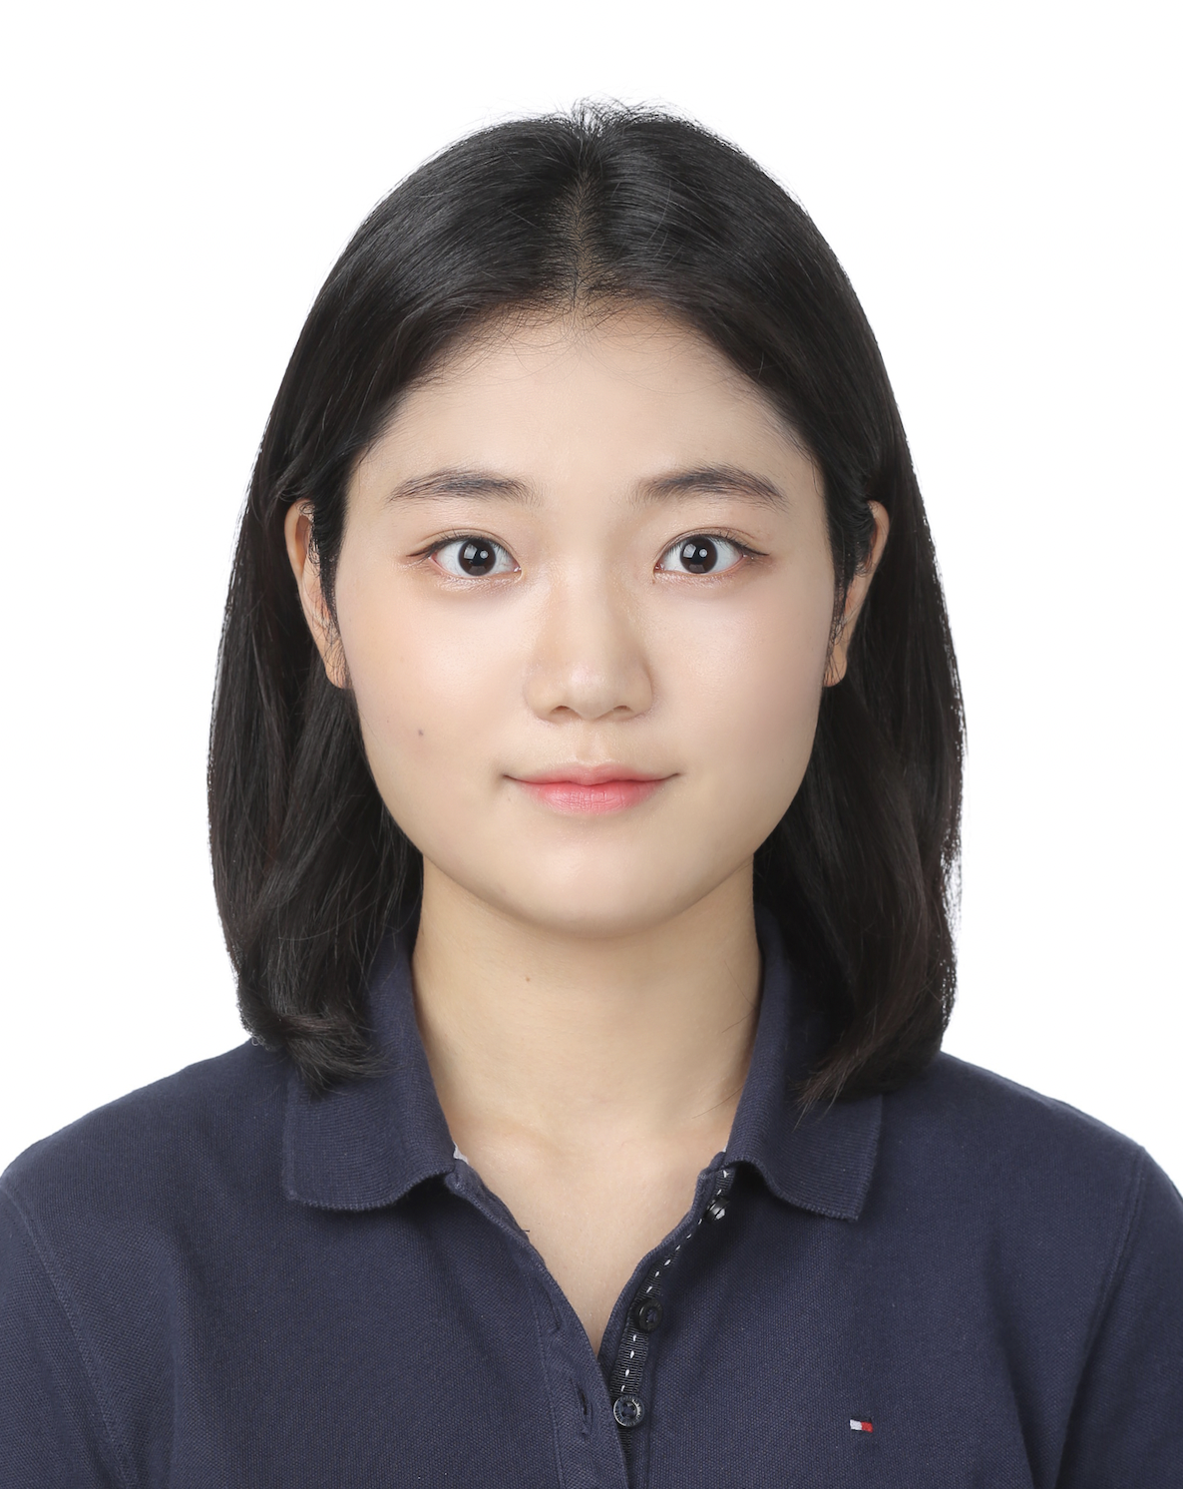
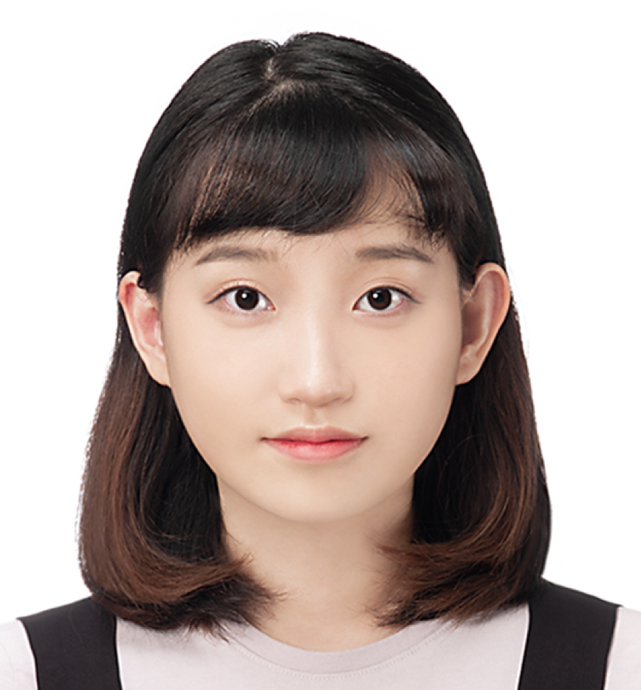
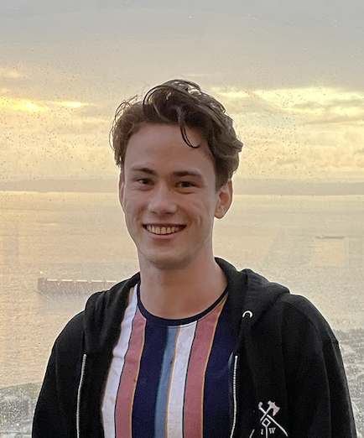
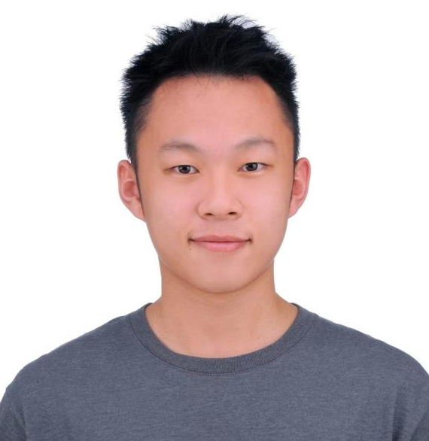
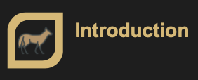
Team members
Hyemin Lim
Chung-Ang University
Computer Science and Engineering
Hyeongjun Kim
Daegu Catholic University
Computer Engineering
Jaehui Boo
Dankook University
Computer Engineering
Nayoun Kim
Woosong University
Information Technology Convergence
Justin Anderson
Purdue University
Network Engineering Technology
Wei-Chieh Chin(Victor)
Purdue University
Computer & Information Technology
Notes:
This is team coyote, we are hyemin lim, hyeongjun kim, jaehui boo, nayoun kim, justin anderson, and victor chin.

Slide 4
Introduction
01
Introduction
Notes:
Let’s start with introduction.

Slide 5
1.1 What has changed since the Midterm
The Things Stack
Throughput
Acoustic
Sensor
NodeMCU
LoRaWAN
Acoustic
Sensor
Raspberrypi
LTE/Wifi
Application
Server
Gateway
MQTT
NodeMCU
Machine Learning /
Deep Learning
Visualize
Acoustic
Sensor
NodeMCU
Notes:
First, I’ll explain what has changed since the Midterm presentation. As you can see, this was our project architecture. The original plan was to record a potential howl, and transmit it via LoRaWAN. However, many experiments presented a critical problem. Throughput.

Slide 6
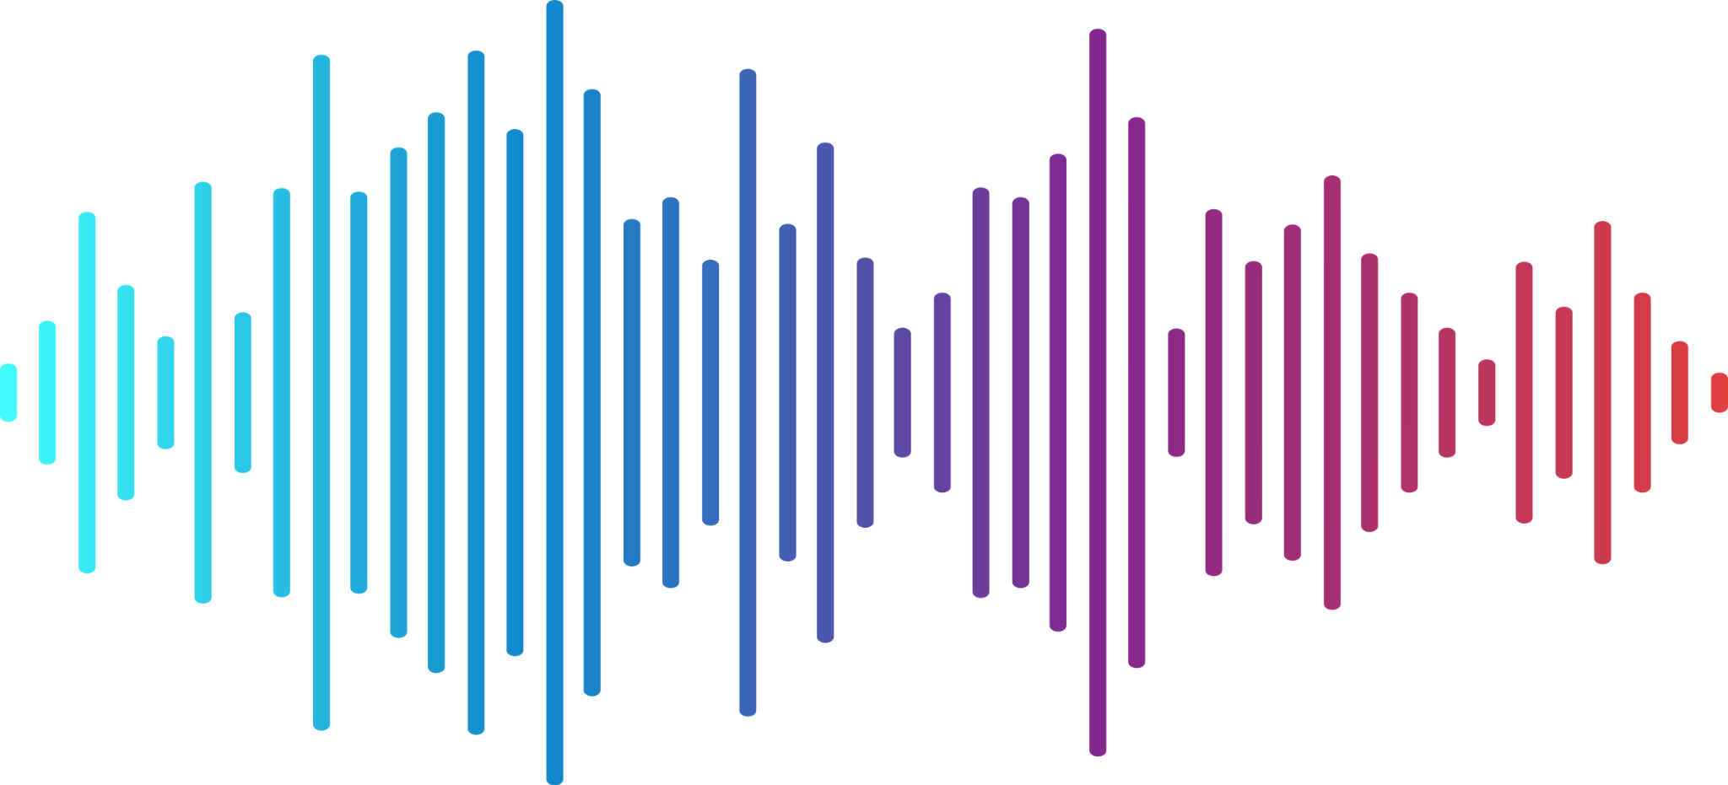
1.1 What has been changed since the Midterm
LoRaWAN Frame
243
Frame Payload
Sig
…121…
Sig
3 seconds of Audio * 16000 sampling rate
= 48000 audio signals
48000 / 121 = 400
Notes:
Normally quality audio has a sampling rate of 44000 Hz. This means one-second of audio requires 44000 audio samples. Even if we compromise the quality of audio by reducing the sampling rate to 16000 Hz, which is the minimum threshold, we still had to send 48000 audio samples to transmit 3 seconds of sound.
The maximum LoRaWAN frame payload size was 243 bytes. one audio sample was 2 bytes, so one LoRaWAN frame can contain total 121 samples. If we divide 48000 by 121, we can know that total 400 frames had to be sent.

Slide 7
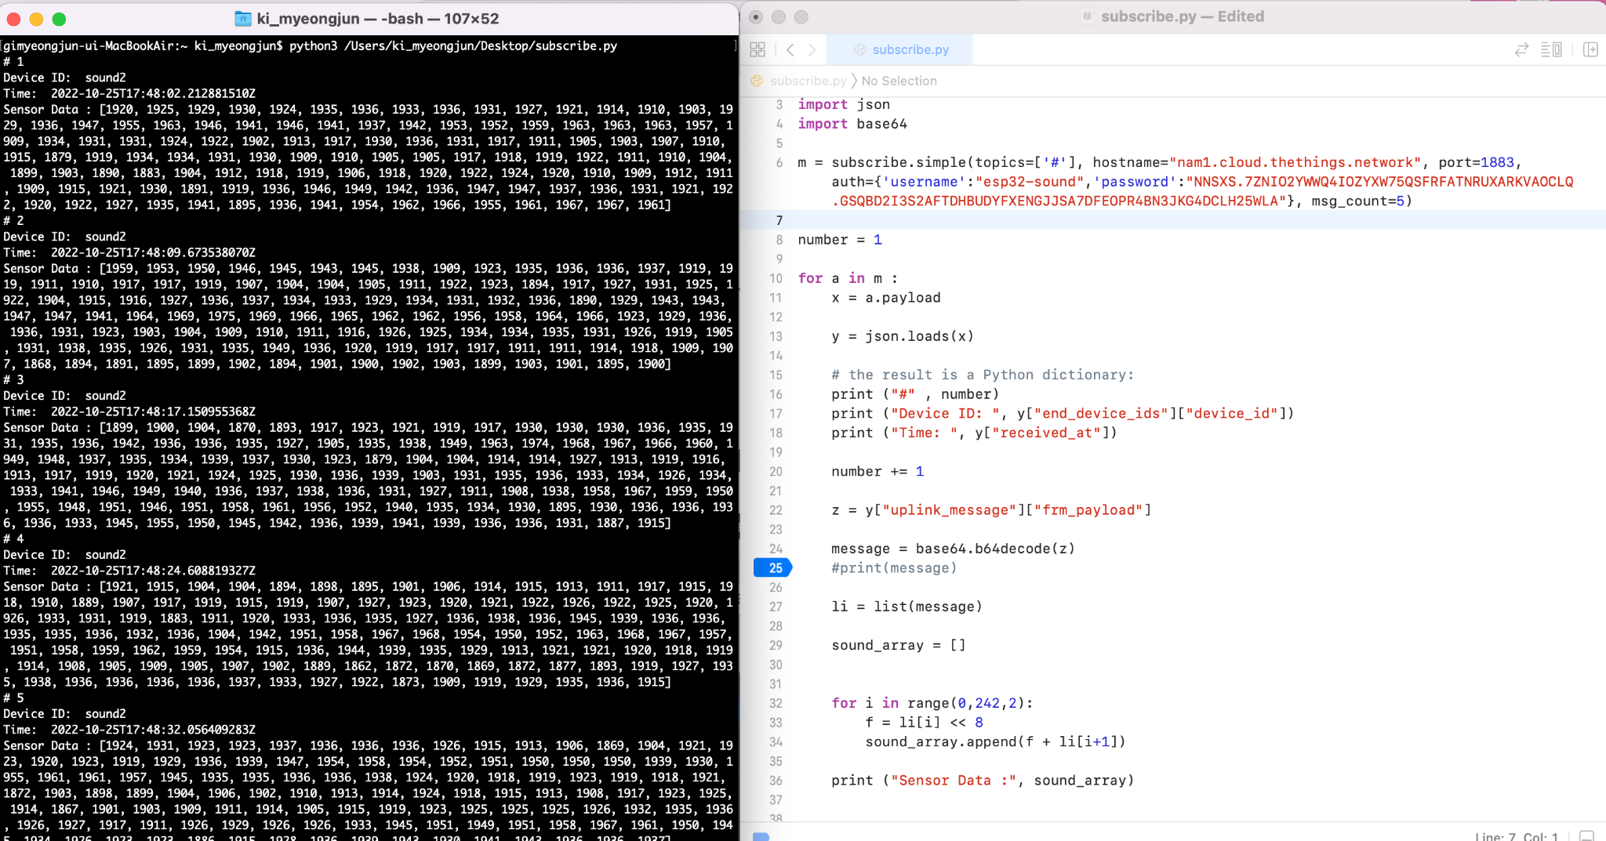
1.1 What has been changed since the Midterm
2600bps
Transmission starts:
17:48:02
Transmission ends:
18:36:02
=48min
Notes:
First we sent one frame with maximum payload and it took almost 7 seconds for The Things Network to receive. Considering that the interval set in the code was 1 second, the Time on Air(TOA) was 6 seconds. We found out that one entire LoRaWAN frame is about 2000 bytes, therefore calculated throughput was approximately 2600 bps. We did the experiment of sending all 48000 samples and it takes 48 minutes. This was too slow for our project’s purpose, making a real-time coyote detection system.

Slide 8
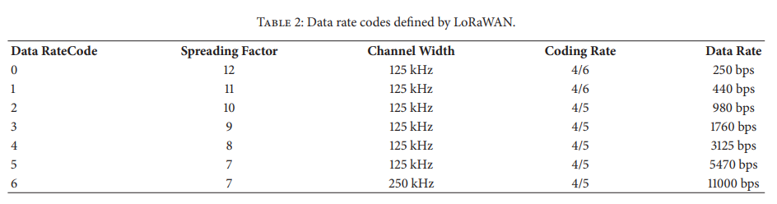
1.1 What has been changed since the Midterm
[1] Hindawi., "Performance Evaluation of LoRaWAN Communication Scalaility in Large-Scale Wireless Sensor Networks”, in WCMC, vol. 2018, June. 2018, Art no. 6730719
7
125kHz
4/5
Notes:
There are three factors that affects data rate(throughput) of LoRaWAN. These are Spreading Factor, Channel Bandwidth, and Coding Rate. We tried to modify these values. But the Spreading Factor and Coding Rate were already optimal. For Bandwidth, we couldn’t change it ‘cause it would heavily decrease the network’s range.

Slide 9
1.1 What has been changed since the Midterm
Acoustic
Sensor
LoRaWAN
MQTT
NodeMCU
Gateway
Machine Learning
Raspberrypi
serial connection
LoRaWAN
NodeMCU
Gateway
Acoustic
sensor
Machine Learning
Notes:
Because we couldn’t further optimize out network’s throughput given our project’s constraints, we had to change the architecture. The new architecture would now classify audio recordings at the end nodes. so that we won’t have to send entire audio data via LoRaWAN.

Slide 10
1.2 New Project Architecture
The Things Stack
Raspberrypi
Acoustic
sensor
Machine Learning
LoRaWAN
(ESP32)
Raspberrypi
MQTT
Localization
websocket
Node.js
(Server)
Gateway
Acoustic
sensor
Machine Learning
Raspberrypi
Acoustic
sensor
Machine Learning
Unity
(Visualization)
Notes:
So this is the new architecture we worked on since then. The end node composition has changed, and visualization platform has been specified.

Slide 11
Implementation
01
02
Implementation
End node connection
Localization
Visualization
Notes:
This section is roughly divided into three subsections, which are end node connection, localization algorithm, visualization platform.

Slide 12
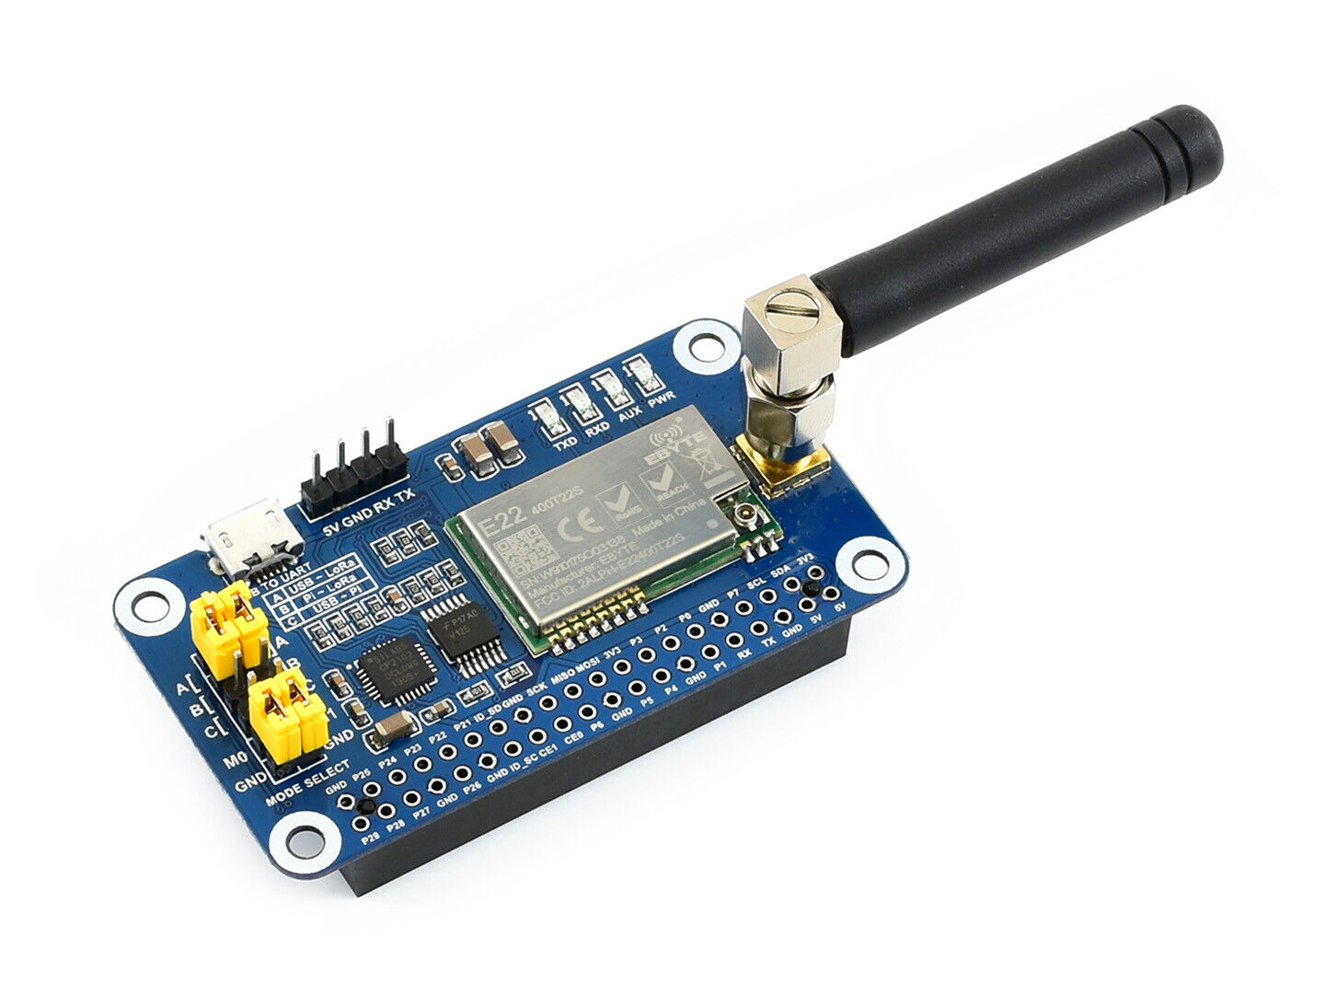


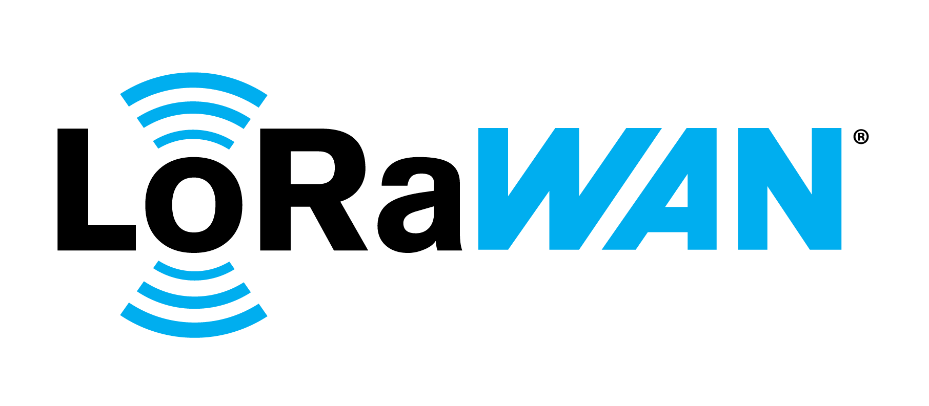
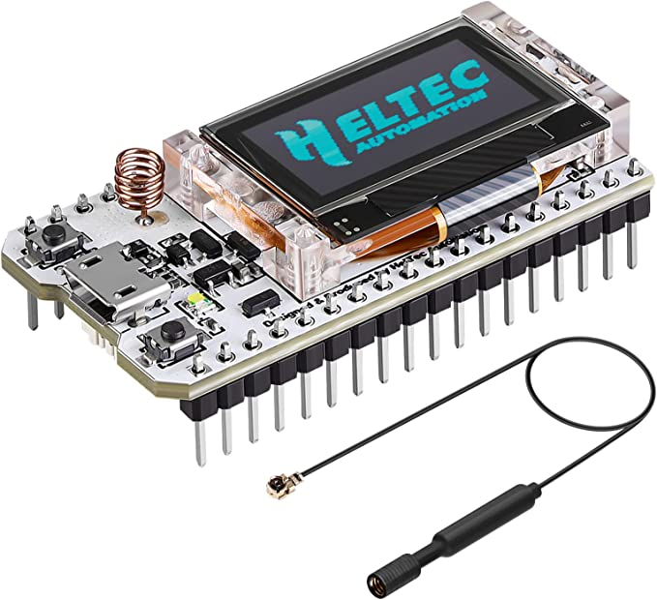
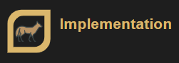
2.1 End node connection
USB
Stable result
easy to use
(thanks to pyserial)
Notes:
We decided to use raspberry pi for our end nodes, so we needed a way for the raspberry pi to interface with the things stack. One way is using a lora hat for the raspberry pi. However, the lora hat we had did not support LoRaWAN, which is different from LoRa. So we had an idea of connecting the raspberry pi and esp 32. The esp 32 will do the LoRaWAN communication while raspberry pi will receive audio signal and run classification model. Since we already achieved esp32 communication with LoRaWAN, all we had to do was connect raspberry pi and esp 32. we found out a library called pyserial that enables raspberry pi to write into serial port of connected board. We easily succeed to connect them with usb cable and it returned very stable result unlike the GPIO connection we tried.

Slide 13
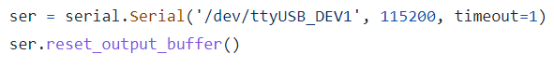
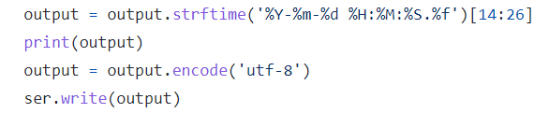

2.1 End node connection
Raspberry Pi
Timestamp
Payload(Timestamp)
ESP 32
Notes:
This is the part of the code inside raspberry pi, which sets up usb serial port connection and write bit string to the serial port. The content will be the timestamp of detection time. And in ESP 32, the message will be read and stored in the payload array and sent to The Things Stack.

Slide 14

2.2 Raw frame data processing
LoRaWAN Frame
base64
Frame Payload
Localization
ascii
time value
calculation
datetime
time difference value
Notes:
From The Things Stack, we can collect frames using MQTT. The frame payload is encoded in base64 format so we had to decode it twice, first in ascii to get the time value and in datetime to calculate time difference value. Then those values go into localization code.

Slide 15
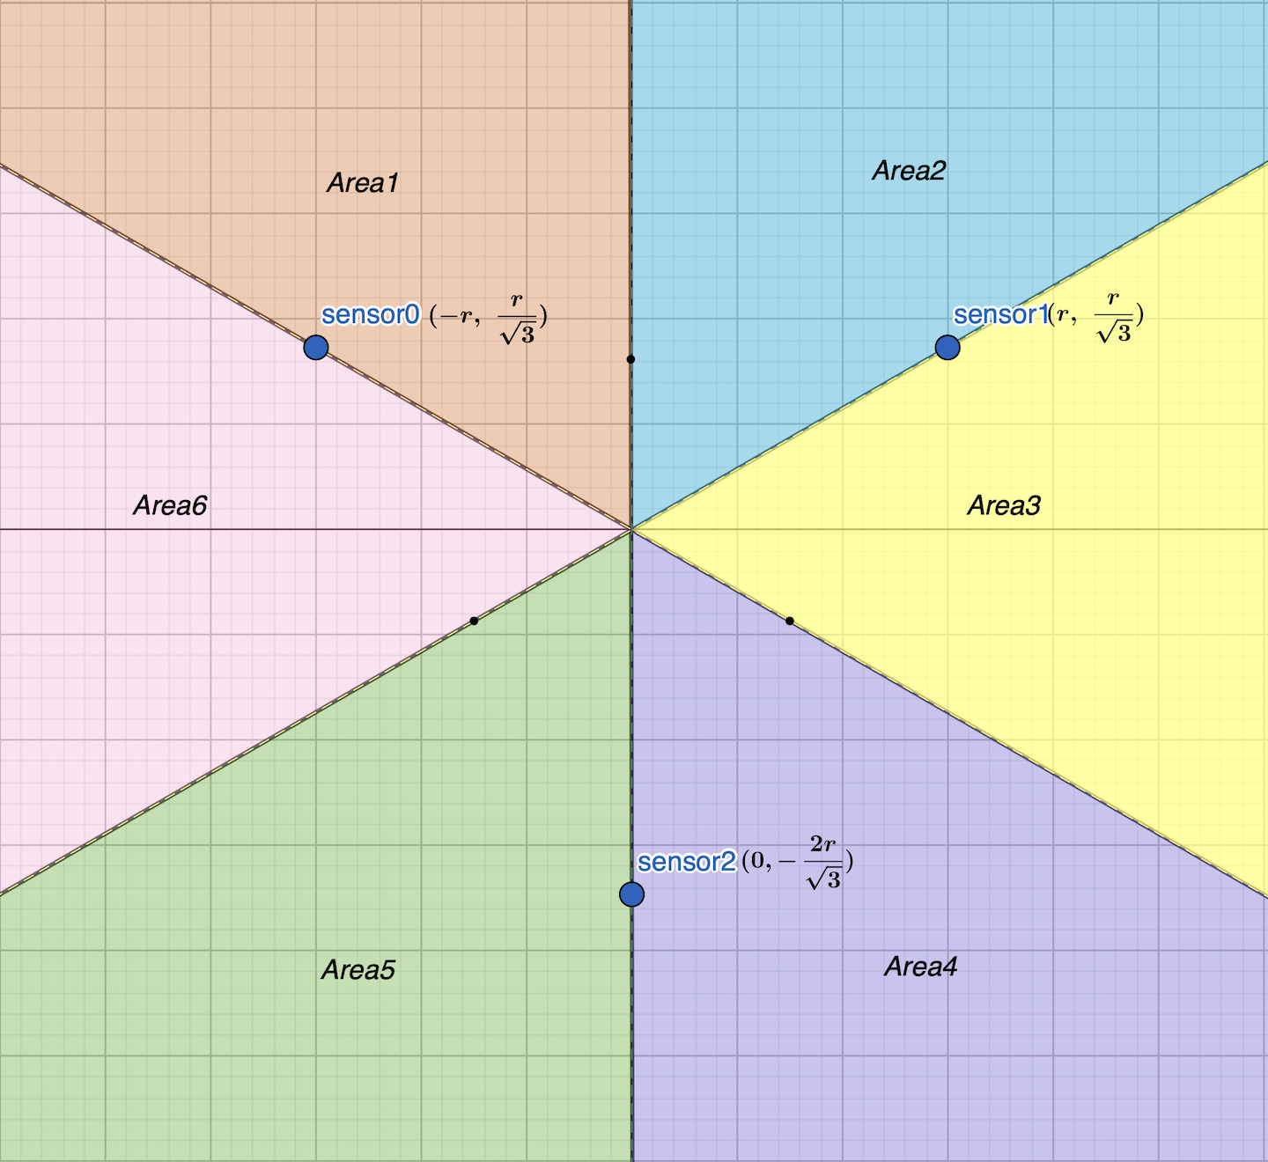
2.2 Localization
Unit: cm, ms
2r
time0_obj
time1_obj
td0
td1
td2
v
Area
time2_obj
Notes:
As a refresher our algorithm uses the intersection of three hyperbolas to locate the sound source. First we set up basic variables. Please note that we set the unit to cm and ms.
2r is the distance between sensors. and sensors are located in the form of equilateral triangle. time_obj is the timestamp indicates the detection time. td0 is the difference of 0, 1 and td1 is between 1, 2 and td2 is between 2, 0. v is the speed of sound. area represents the section sound source is located.

Slide 16
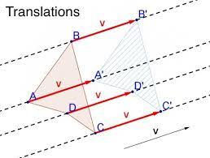
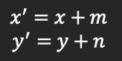
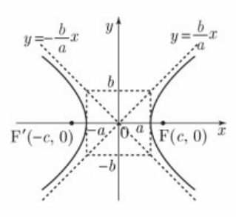
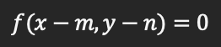
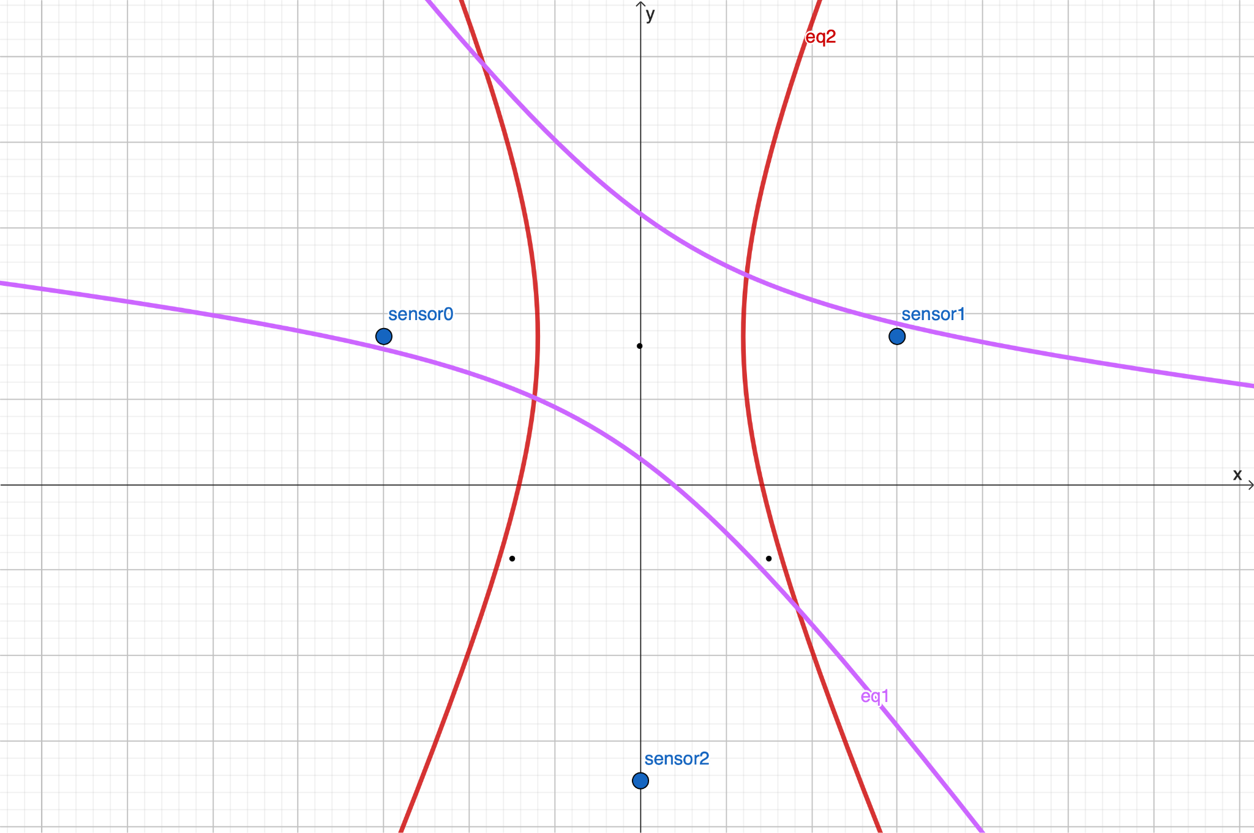
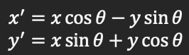
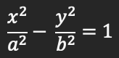
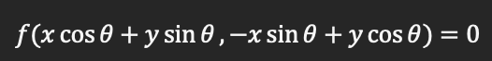
2.2 Localization
Hyperbolic function
Parallel Translation
Rotation Transformation
Notes:
In code, we draw hyperbolas by using parallel translation and rotation transformation of points and coordinate planes.

Slide 17
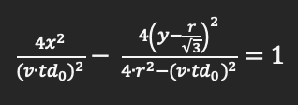
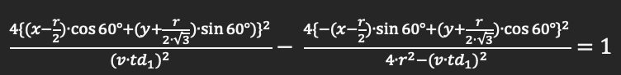
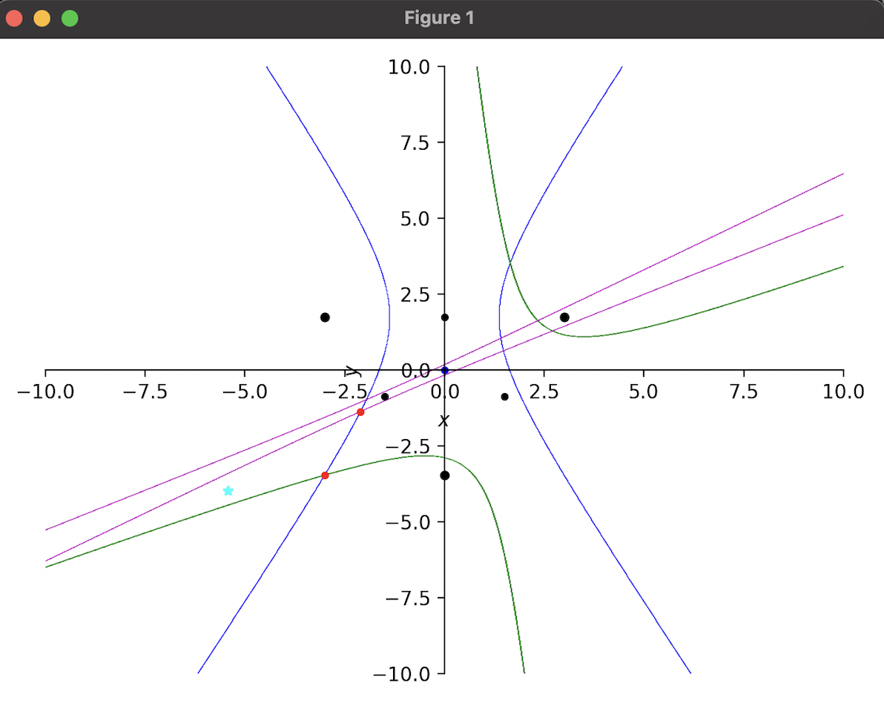
2.2 Localization
Notes:
We first make hyperbola equation with the time difference value assuming its center point is (0,0) and the angle is in line with the x and y axis. Then we shift the function according to the center of two sensors and rotate according to the angle of the line two sensors draw. If we do this process for every pairs of sensors, a graph like this comes out. This is the equation of blue hyperbola, and this is for green, this is for purple one.

Slide 18
2.2 Localization
2
3
1
Notes:
Then we need to get the intersection point of them. These red point you can see is the intersection of two hyperbolas. We tried to get the intersection point of all three of them but it was almost impossible due to complex number and the characteristic of location coordinates. so instead, we first get the general direction of the sound source using the order that signal arrives to each acoustic sensor. These numbers are the order, which means the sound source is located in this area. and we get all the points that two hyperbola intersect in that area and calculate the average of it. The blue(cyan) point you see is the calculated result.

Slide 19
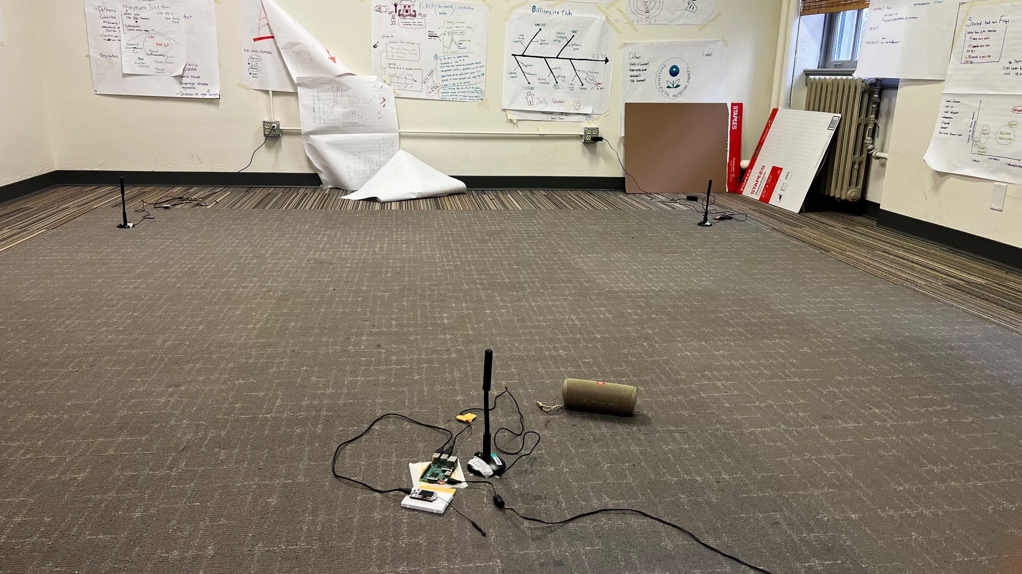
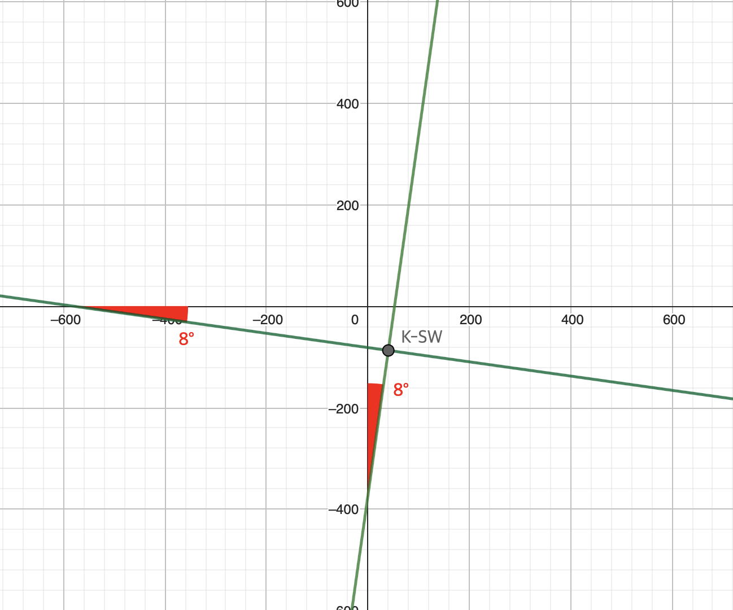
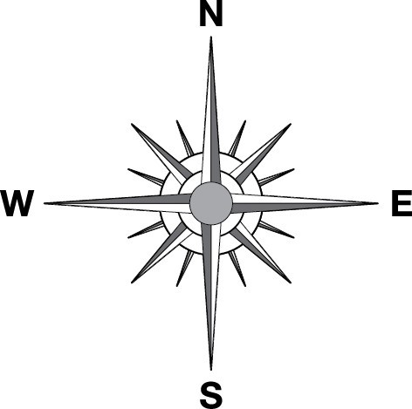
2.2 Localization
(m, n)
(40.426…, -86.909…)
(unit: cm)
(unit: °)
Notes:
However, the calculated result was not actually in the geographic coordinate plane. So to convert that, we had to do two things. First is setting the center point variable m, n to the actual coordinates. These number are the latitude and longtitude of KSW we set for the experiment. Second is to measure the difference of cardinal direction and rotate the blue point by that angle. For example, in the experiment the difference is 8. So we applied rotation transformation by 8 degree to our result.

Slide 20
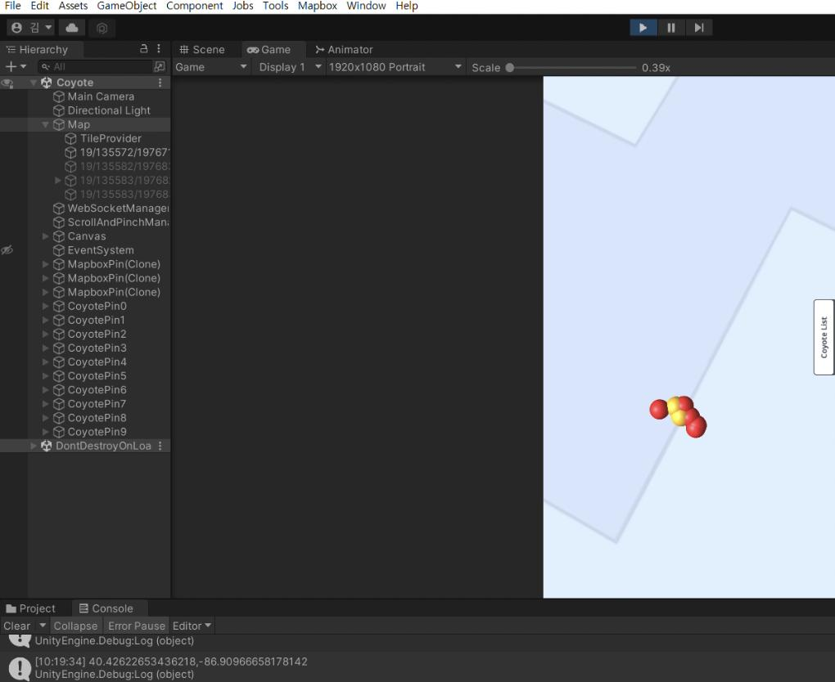
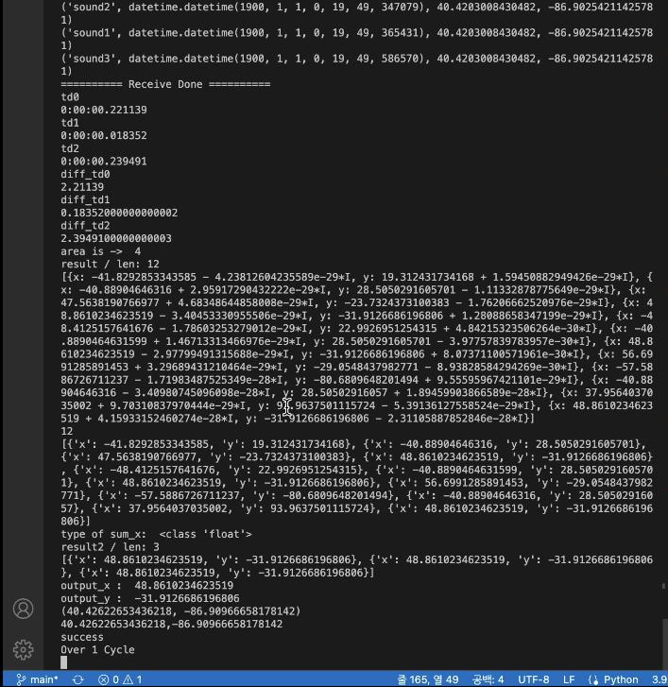



2.3 Visualization
coyote detection history (recent 5)
sensor coordinates
Localization
coordinates
http
websocket
real-time detection
websocket
Mapbox SDK
collections
sensors
coyotes
Notes:
Localization code return the coordinates of detected coyote sound and send it via websocket protocol. Node.js server receives those data and broadcast to unity client as it stores them in DB. The server also uses http protocol to send last 5 detected location of coyotes and all of the sensor coordinates. Unity receives all of the coordinates and loads them as a pin on a 3D map made by an external API, Mapbox SDK.

Slide 21
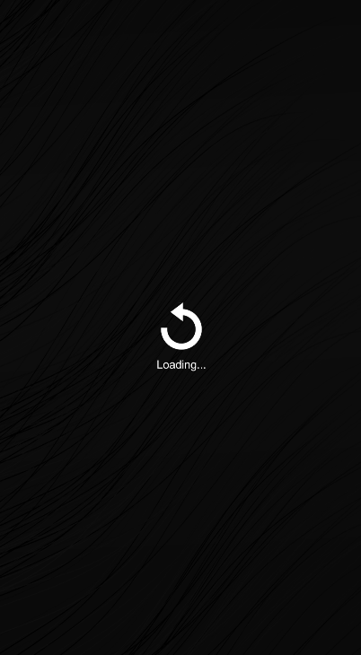
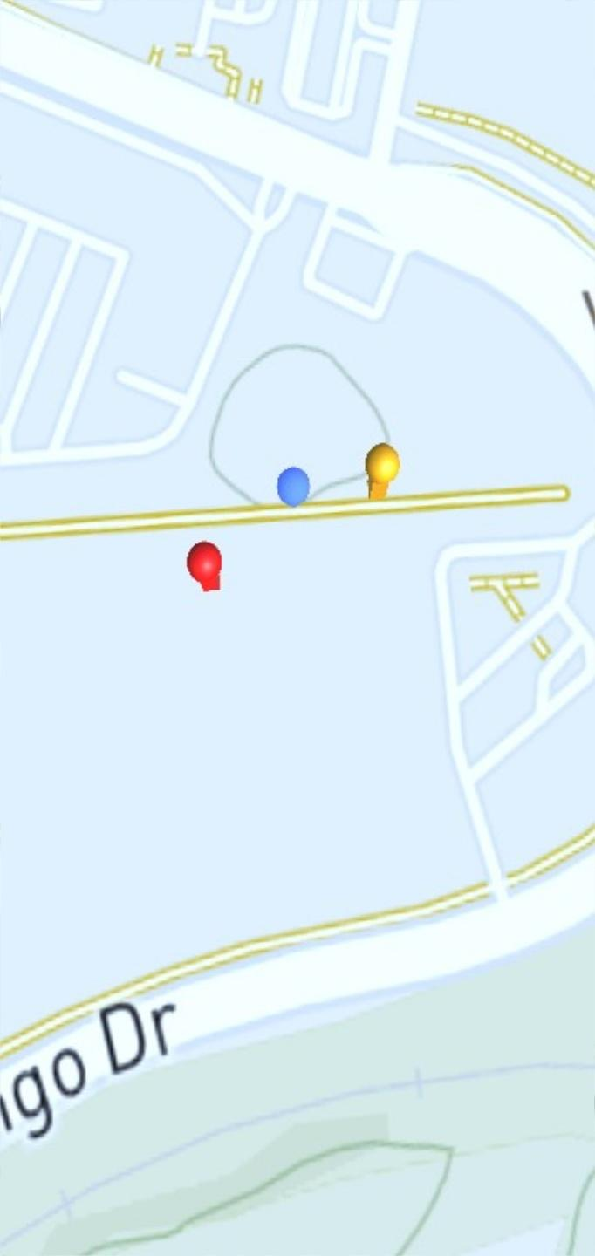
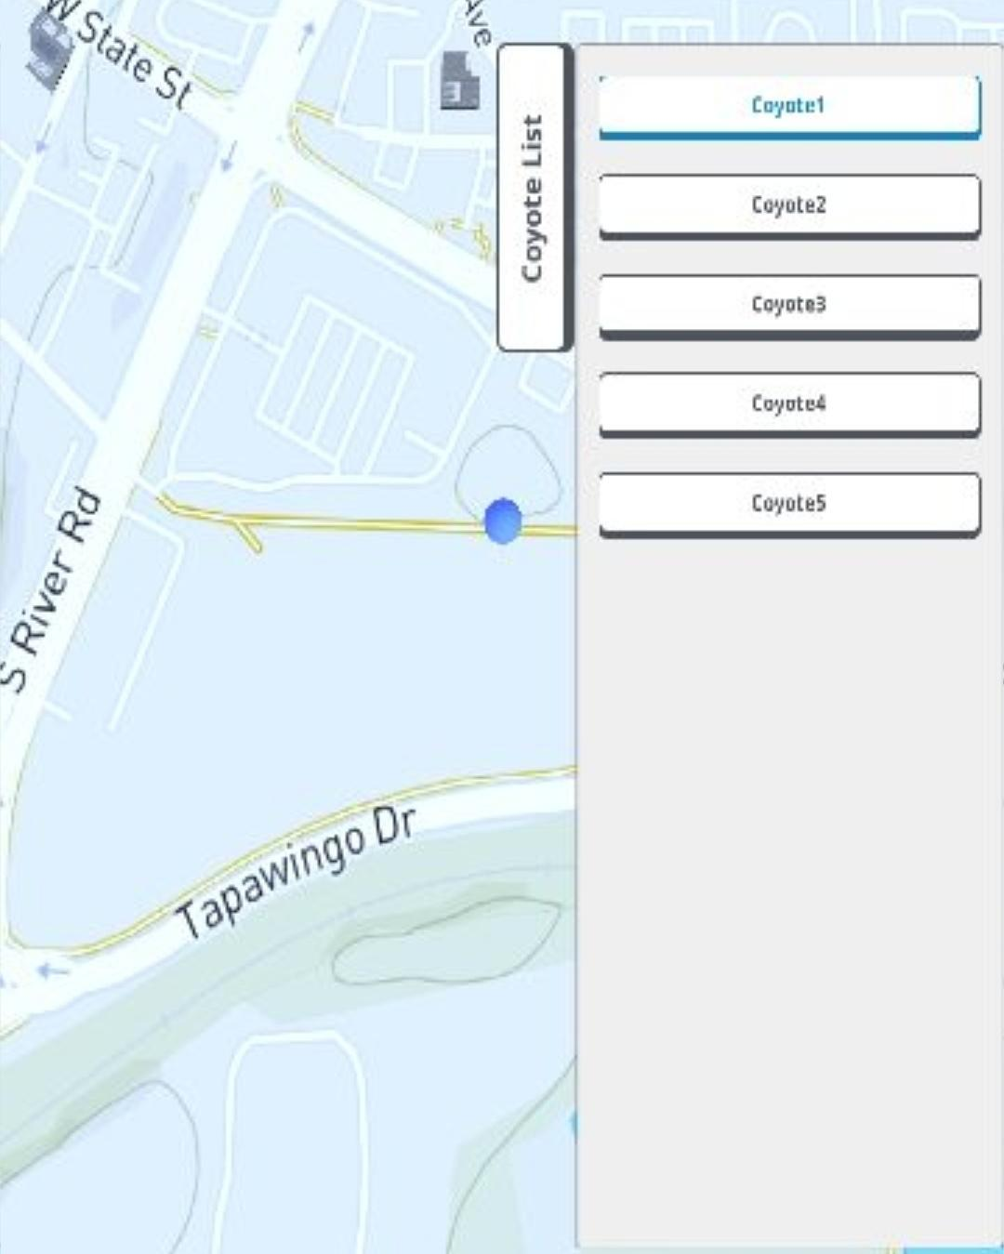
2.3 Visualization
Notes:
These are screenshots of actual visualization platform. First one is loading scene, all initial information is stored during this. it prevents memory leak caused by http request from client side.
Second is coordinate pins. the blue one is for sensors, yellow indicates recent 5 coyotes detected. the red one represents coyotes detected in real-time, after the initialization.
third one is the list view of coyotes, if you touch those items, camera will automatically focus that coyote pin location.

Slide 22
Experiment
03
Experiment
Notes:
This is the end of implementation, now hyeongjun will explain our experiment on localization algorithm.

Slide 23
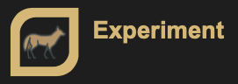
3. Experiment
Sound Detect
Packet
ESP32
Gateway
Sensors
(Each sensors distance is same)
Localization
Notes:
The team did many experiments for accuracy testing after we complete the localization algorithm. These experiments were done in our own settings because we couldn’t combine coyote team 2’s machine-learning model with our code in this moment.
So we set up an environment for our experiment. Each microphone was equidistant. the code for the esp 32 transmits a LoRaWAN frame if a sound breaks a decibel threshold

Slide 24
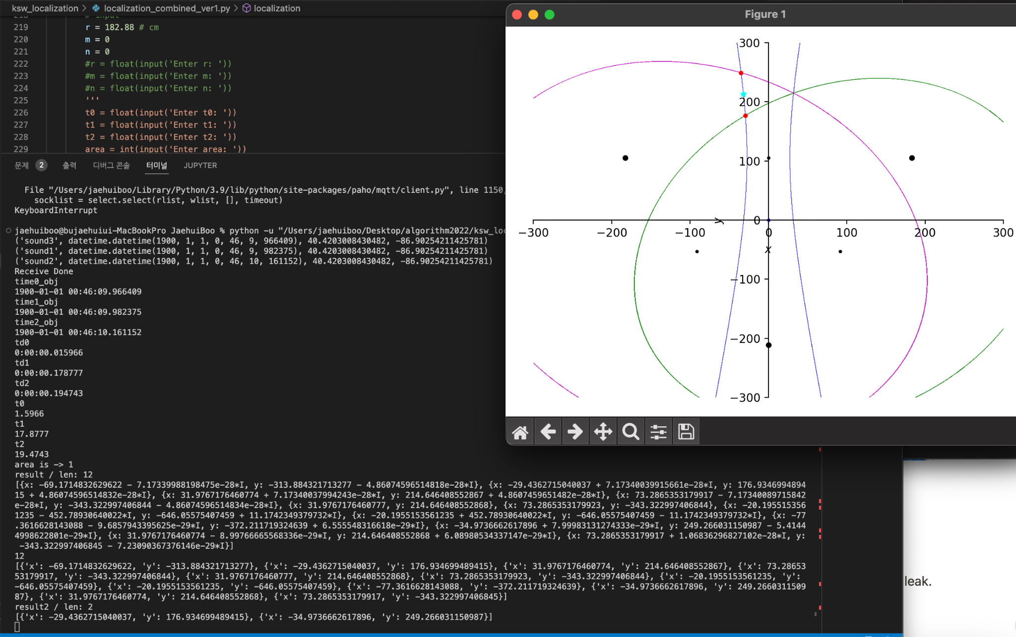
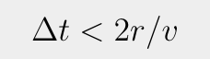
3. Experiment
Wrong Result
Notes:
When we conducted the first experiment, only one hyperbolic function was drawn: the other two were ellipses. Sometimes all three of them were ellipses. This was unexpected. So we tried to figure out the condition that differentiates ellipse and hyperbola. To make a hyperbola, The time difference must be less than the distance between the microphone divided by speed of sound.

Slide 25
3. Experiment
Sensor Distance: 60ft
Sensor Distance: 144ft
Notes:
So we thought maybe the problem is the distance between microphones. So we tried placing microphones closer to each other. We did two experiments but the result was not different.

Slide 26
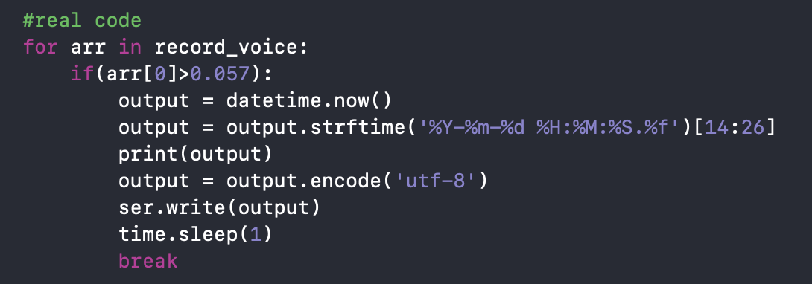
3. Experiment
Notes:
Next, we verified the accuracy of the timestamps. We found that the timestamps were created when the gateway received the frames, not when the microphone began recording. We believed that this is why the time difference was so significant that it drew an ellipse. We had our program make a timestamp when the microphone started recording, so we could avoid delays in transmission. Unfortunately, because TDOA utilizes the absolute time difference, and the data rate was constant, it should have still produced accurate results. It was possible that the algorithm was flawed.

Slide 27
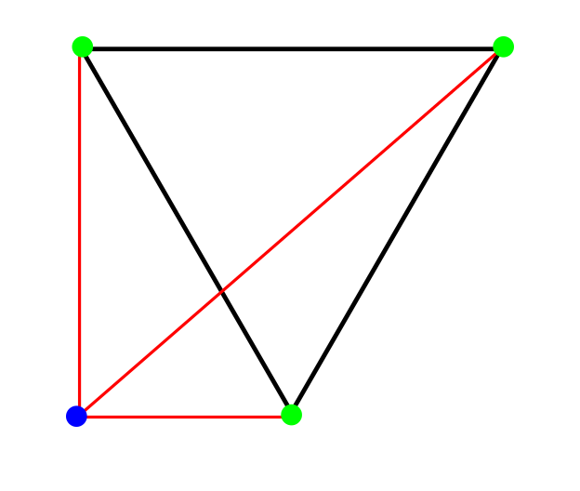
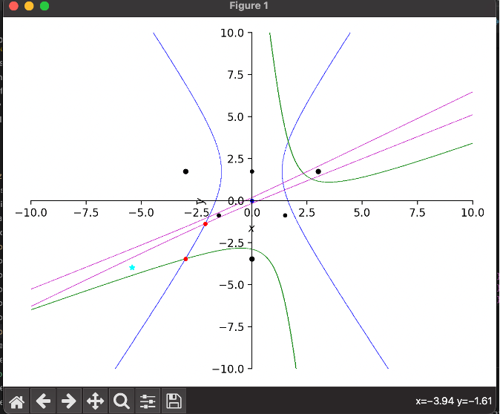
3. Experiment
Sensor0
Sensor1
Sensor2
Notes:
We tested it by setting an arbitrary point and calculating the theoretical time difference. This was compared to the actual time difference measured and they were within an acceptable threshold.

Slide 28
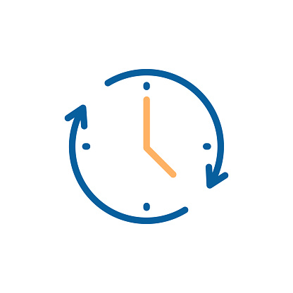
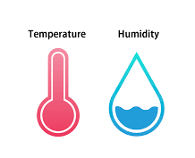
3. Experiment
Time Delay?
Notes:
So we focused on the time delay. The speed of sound varies with temperature or humidity, but our experimental environment is too narrow to consider the problem, so we can conclude that there is a time delay during the accepting and processing sound. So we thought about the factors that could delay the time.

Slide 29
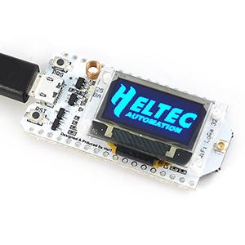
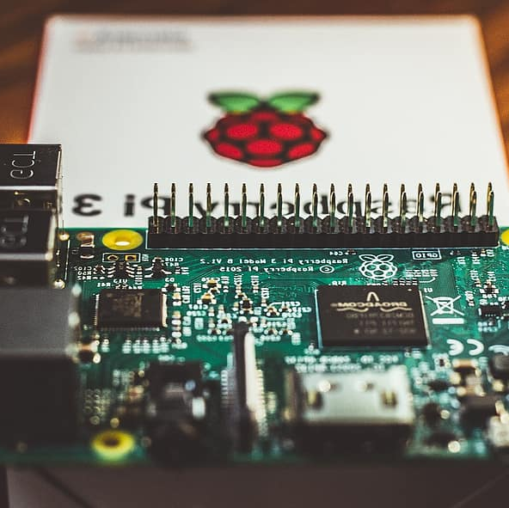
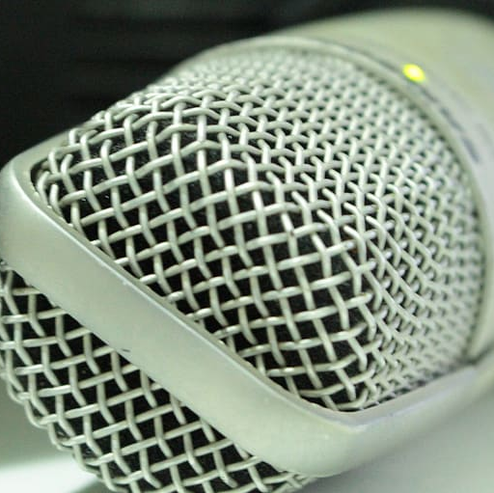
3. Experiment
Time Delay?
1m Length usb cable took 10ns to communicate
Notes:
First, we thought that there might be a delay as the microphone, Raspberry Pi, and esp32 communicate. But the 1m length usb cable took 10ns to communicate, and it was too small to cause any problem, so we can ignore it.

Slide 30
3. Experiment
Sound1
Sound2
Sound3
AVG : 31.096ms
AVG : 33.565ms
AVG : 37.038ms
Biggest problem is
recognition accuracy
Notes:
Second, we thought there might be a problem with the microphone's delay time, so we conducted an experiment to find the microphone's latency, and found that the microphone's average latency was about 34ms. However, the Localization code uses a method of obtaining the time difference between each microphone, so it is concluded that the difference in latency between each microphone is not a big problem when compared.

Slide 31
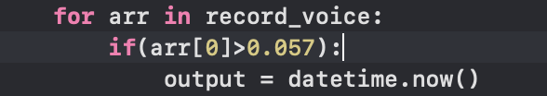

3. Experiment
Notes:
So, we thought there could be a problem with the size and recognition accuracy of the microphone, so we conducted several experiments while controlling the sound of the microphone. When we adjusted the microphone setting to make it filter background noise and only hear the sound above a certain level we used in the experiment, the time difference seemed to be reduced a little bit. But it was still not enough to get the result we wanted. So we thought of another way, modifying the recognition accuracy of microphones.
Third, the experiment was conducted by changing various setting values of the microphone. We adjusted the sensitivity of the microphone first. because we vary the value is that the order of detection should be set according to the distance between microphones and the sound source, but it got mixed very often. So we adjusted it and proceeded with the experiment again, and although it was better than before, we still got similar results as before the sensitivity was adjusted.
=====================
So, we thought there could be a problem with the decibel size and recognition accuracy of the microphone. So, we conducted several experiments while controlling those factors. Conclusively, we found certain value of decibel that we define as the sound and the appropriate microphone volume to keep the external sound almost out of the door. Although it was better than before, we still got similar results as before the factors were adjusted.

Slide 32

3. Experiment
Frame Value
📌
10ms
1ms
0.1ms
Notes:
next, we adjusted the frame value of the sound recording code. The initial setting of the microphone frame was 10 ms. So we thought that if the frame value was reduced, the time when the sound was detected would be more accurate, so we reduced the frame interval to 1 ms. The lag between sensors after reducing the frame value to 1 ms was much better than before. The lag before adjusting the frame was usually more than 100 ms, but after, it was 40 to 70 ms. So we thought that if we cut it down further, the time difference would decrease further, and we reduced the frame interval to 0.1 ms, but the delay was getting bigger. So we decide to use 1ms frame interval

Slide 33


3. Experiment
Sampling Rate x 2
Notes:
and we doubling the sampling rate for time stamps accuracy but It was not different then before

Slide 34

3. Experiment
Calibration Value
Notes:
Through many of these experiments, we thought that the biggest problem was the recognition accuracy of the microphone and the large delay time. we reduced the time difference more than at first, but there was still big time difference for accurate results. So we decided to do a calibration process.

Slide 35
3. Experiment
acoustic sensor
Sound Source
Notes:
We experimented by multiplying many numbers by the time difference to find corrections that could reduce the time difference, and the calibration value with the highest accuracy was 10. So we conducted the experiment after multiplying the time difference by the calibration value and setting the frame interval to 1ms.

Slide 36


3. Experiment
Correct Location!
Notes:
Due to the low recognition accuracy of the microphone,sometimes the order of detection is not same with we expected. But if the microphone recognized sound in the same order as the theory we thought, we could get very accurate results. So we expect that if we use a microphone with high recognition accuracy, we have a tremendous increase in the likelihood of getting accurate results.

Slide 37

3. Experiment
Notes:
And Last week we’ve also done the experiment of combination of two teams. This is the demonstration video.

Slide 38




3. Experiment
Notes:
When Machine Learning model succeed in recognizing coyotes, it extract a timestamp. that the peak of the sound and send it to the things network server via LoRaWAN and use it as an input of localization algorithm.

Slide 39
Future Works
04
Future works
Notes:
next, out future works.

Slide 40

4. Future Works
Calibration Value should be change
Future Works
Notes:
The designated environment setting of our project was a rural, open area. However, we conducted simple experiments indoors. That’s because we only have two 4GB raspberry pi for now. If we get the last one, we can do localization with actual coyote classification results. Then the constraints such as sensor sensitivity will be gone and the outdoor experiment will be available.

Slide 41
[References]
[1] Wave Share. “SX1262 868M LoRa HAT” Wave Share. Accessed: Nov, 2, 2022. [Online]. Available: https://www.waveshare.com/wiki/SX1262_868M_LoRa_HAT
[2] Spotpear. “Raspberry Pi SX1262 868M LoRa HAT User Guide” Spotpear. Accessed: Nov, 2, 2022. [Online]. Available: https://www.spotpear.com/index/study/detail/id/244.html
[3] sb Components. “Getting started with LoRa™ Hat for raspberry pi” sb Components. Dec, 10, 2021. [Online]. Available: https://shop.sb-components.co.uk/blogs/posts/getting-started-with-lora-hat-for-raspberry-pi
[4] Jac. K. “Gateway SX 1262” The Things Network Forum. Jun 13, 2021. [Online]. Available: https://www.thethingsnetwork.org/forum/t/gateway-sx-1262/48750
[5] viveknayyar007 “How To Change Default Internet Connection Sharing IP Address Range” Tom's Hardware Forum. Dec, 12, 2013. [Online]. Available: https://forums.tomshardware.com/faq/how-to-change-default-internet-connection-sharing-ip-address-range.1606758/
[6] Lydia. C. “Connecting a Raspberry Pi to a Laptop Display” Atomic Object. Jun, 9, 2019. [Online]. Available: https://spin.atomicobject.com/2019/06/09/raspberry-pi-laptop-display/
[7] Dexter Industries “Connecting to Raspberry Pi without a monitor for Beginners” Dexter Industries. Accessed: Nov, 2, 2022. [Online]. Available: https://www.dexterindustries.com/howto/connecting-raspberry-pi-without-monitor-beginners/
[8] jurosofish, “multilateration” Github.com, Nov, 4, 2022. [Online]. Available: https://github.com/jurasofish/multilateration/pulse
[9] automaticaddison. “Two Way Communication Between Raspberry Pi and Arduino” Automatic Addison. Jul, 6, 2020. [Online]. Available: https://automaticaddison.com/2-way-communication-between-raspberry-pi-and-arduino/
Notes:
these are our references.

Slide 42
[References]
[10] Hopkins. J. “Understanding the difference between UART and USB” Totalphase. Accessed: Nov, 11, 2022. [Online]. Available: https://www.totalphase.com/blog/2022/01/understanding-differences-between-uart-and-usb/
[11] Press Start. “Unity - Mobile Panning with a Perspective Camera” Youtube. Nov, 9, 2018. [Online]. Available: https://www.youtube.com/watch?v=4_HUlAFlxwU
[12] Google. “Maps SDK for Unity Key Concepts” Googles map platform. Accessed: Nov, 9, 2022. [Online]. Available: https://developers.google.com/maps/documentation/gaming/concepts_musk
[13] Kristopher C. “A Guide to Using Google’s Maps SDK for Unity 3D - Part 1” Medium. Apr, 19, 2021. [Online]. Available: https://medium.com/everdevs-community/a-guide-to-using-googles-new-maps-sdk-for-unity-3d-ed1d68b2305e
[14] Ahmed. S. “WebSocket Client & Server (Unity & NodeJS)” Medium. Dec 6, 2020. [Online]. Available: https://medium.com/unity-nodejs/websocket-client-server-unity-nodejs-e33604c6a006
[15] SymPy Development Team. (2022). Accessed: Aug. 22, 2022. [Online]. Available: https://docs.sympy.org/latest/tutorials/intro-tutorial/index.html
[16] Python. “datetime” python software foundation. Accessed: Nov, 16, 2022 [online]. Available: https://docs.python.org/3/library/datetime.html
[17] mapbox. “Maps SDK for Unity” mapbox docs Guides. Accessed: Nov, 14, 2022 [online]. Available: https://docs.mapbox.com/unity/maps/guides/
[18] Mapbox. “Build a Unity 3D game Introduction to PocketDroids GO and the Mapbox SDK for Unity” Youtube. Jun, 14, 2018 [online]. Available: https://www.youtube.com/watch?v=RhG1kfDBhgM

Slide 43
Q&A

Slide 44
Thank you

